Slide 1



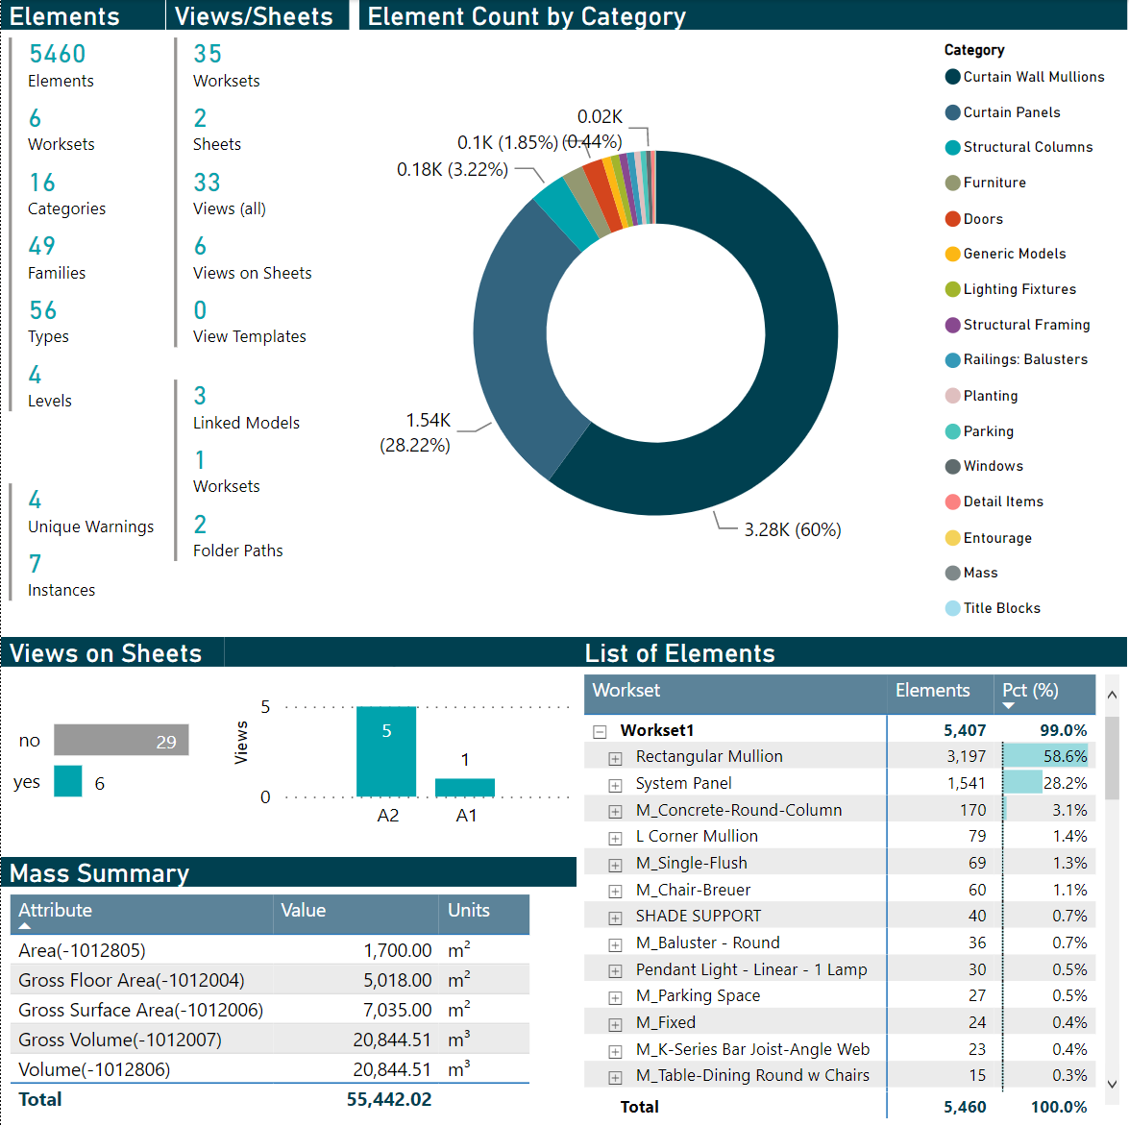
Creating an Actionable Revit Model Health Dashboard using Dynamo and Power BI
June 15, 2022
James Feracor, Digital Design Technologist
Sean McDonald, Corporate BIM Manager
Kristopher Dane, Director of Digital Design
Digital Built Week Americas 2022
Anaheim, California

Slide 2
outline
Introduction
Digital Design at Thornton Tomasetti
Speakers
Problem
Solution Outline
Live Demo
Deep Dive into Tool Components
Dynamo
Power BI
Q/A

Slide 3


introduction
Digital Design (D2) at Thornton Tomasetti
Design Practices
Information Technology
Structural Engineering
Construction Engineering
Protective Design
Forensics
Renewal
Digital Design
Why? So project teams can do work that is worth their time; to focus on high value, high impact problems rather than the commodity activities.

Slide 4



introduction
Presenters
Dr. Kristopher Dane
Director of Digital Design
Seattle, WA
Sean McDonald
Corporate BIM Manager
Chicago, IL
Dr. James Feracor
Digital Design Technologist
Seattle, WA
We’re hosting another session tomorrow at 10:45am: 3.2.08 “AirTable for Version Tracking of Revit Details”

Slide 5
The Problem
Model Review is Hard
Some questions for models
Checking Revit models is resource intensive!
Time-consuming, tedious, and inconsistent when performed manually
Not easy to query / search elements in model using Revit UI… and tons of elements!
Need ability to diagnose model health quickly, consistently, on demand
Checks yield info valuable in diagnosing potential model issues / measuring model health
How many sheets do I have?
How many views are on sheets?
Are the right kinds of things in the right views?
Are objects in the correct worksets?
How much and what kind of stuff so I have in my model?
What are the design quantities of the model elements?
Can I dump model data to Excel for further analysis?

Slide 6



THE Solution
x5
TASK 1:
Dynamo Scripts -> JSON files
User manually triggers Dynamo scripts…
POWER QUERY EDITOR
TASK 2:
Update Power BI Template
to read JSON files + refresh data
Power BI Template ingests data automatically!
TASK 3:
Customize Report for intended end users in Power BI
DATA MODEL + REPORT EDITOR
TASK 4: (Optional)
Improve workflow for repeatability
End users consider opportunities to scale + streamline workflow
We’re going to make solution available to all of you (via GitHub)!

Slide 7
Live Demo

Slide 8
revit model

Slide 9
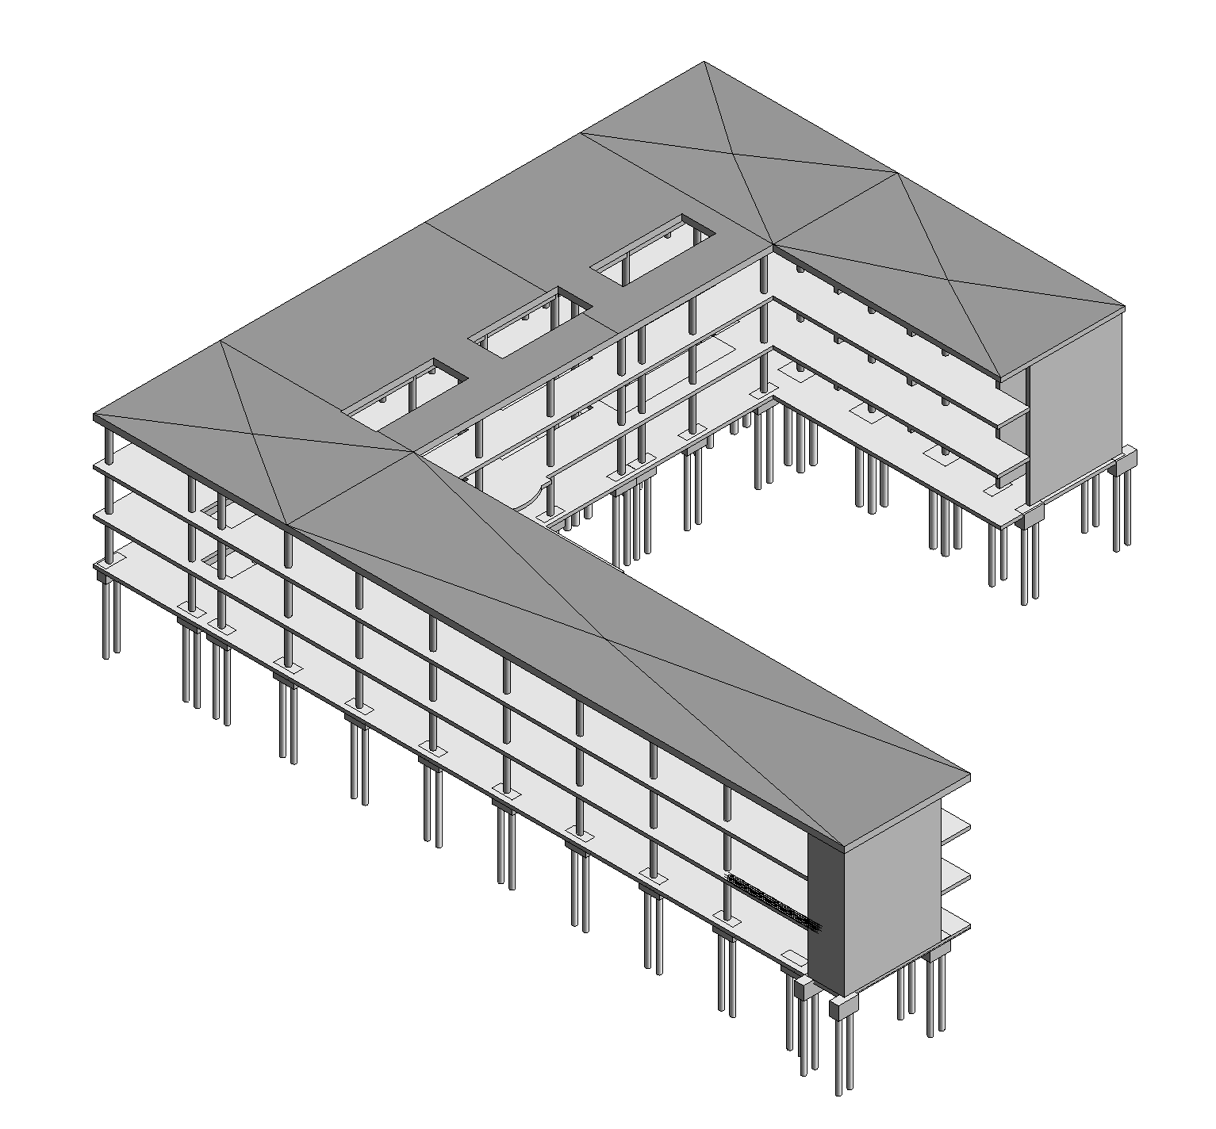
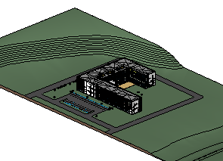
The model
Revit Sample Models

Slide 10
Dynamo scripts
x5
POWER QUERY EDITOR
REPORT EDITOR

Slide 11
Why Dynamo
Why Dynamo
Its free and installed with Revit
“Easily” modifiable
Drawbacks to Dynamo
It can be slow
It needs to be run manually
It can be prone to issues
Issues can be machine specific
You can’t stop a run without killing Revit

Slide 12
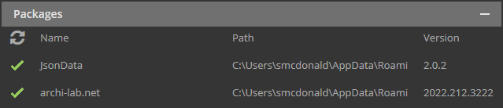
Requirements
Packages
JsonData Exporting Revit data to JSON
Archi-lab.net Element selector Linked model info
Sample Files
Creating using the Autodesk Revit Architecture and Structure sample files (both basic and advanced)
Modified slightly and linked to make the data export slightly more realistic
Revit
Sample made using 2022.1.2

Slide 13
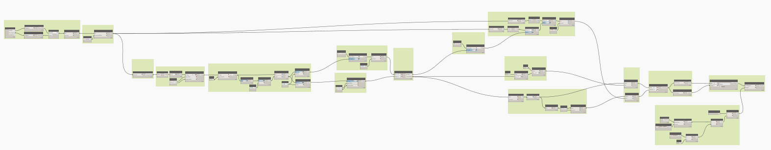
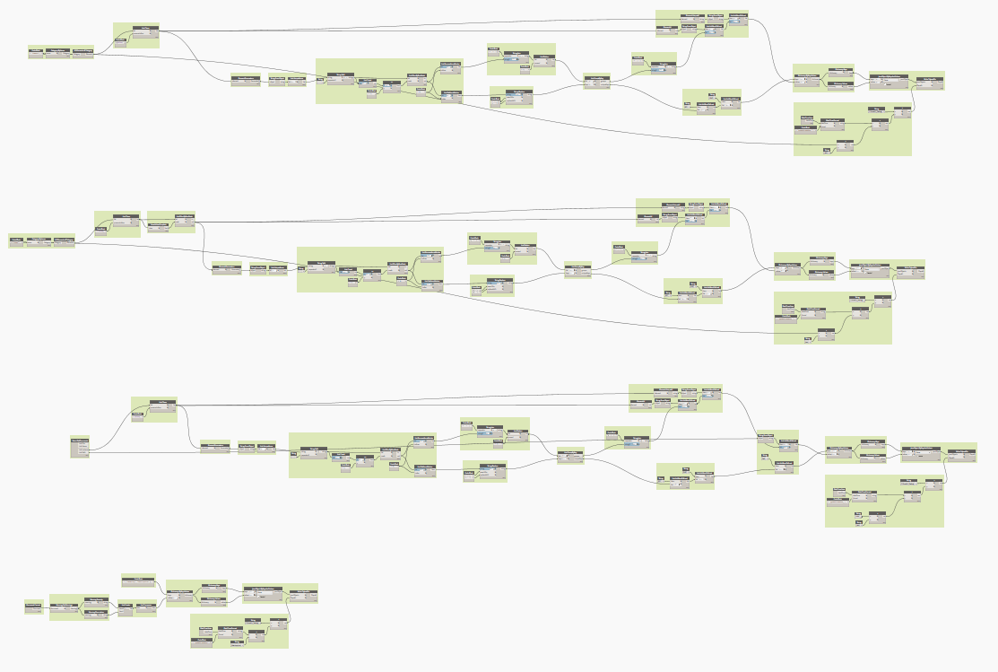
the scripts
Script 1: Elements
Script 2: Links, views, sheets, warnings

Slide 14
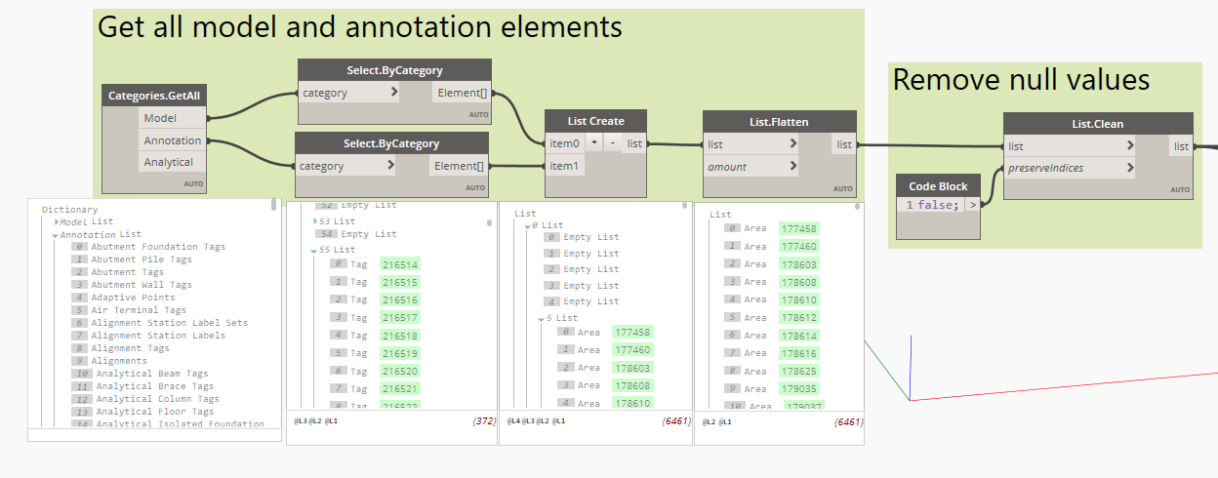
script 1 | Element Data
Using archi-lab.net collector to get all model and annotation categories list
Selecting all elements by category using those categories
Flattening and cleaning the list of elements

Slide 15
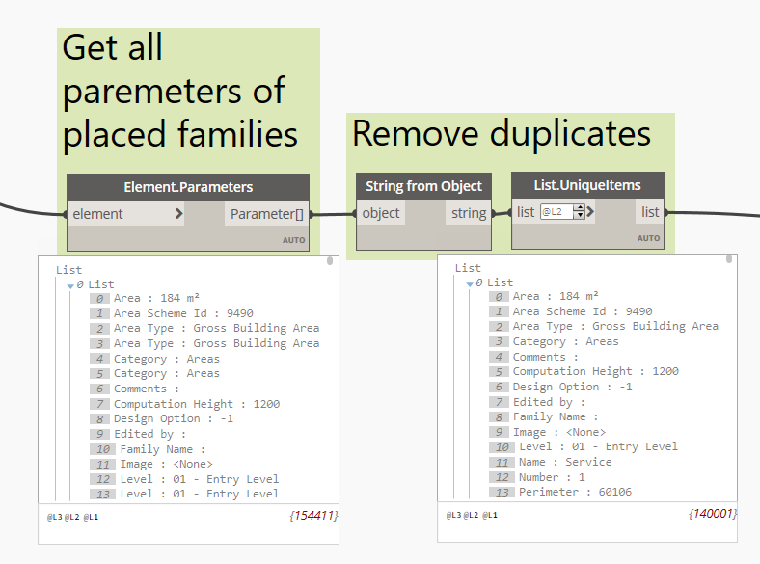
script 1 | Element Data
Get all parameters from the list of elements
Convert to string and remove duplicate items

Slide 16
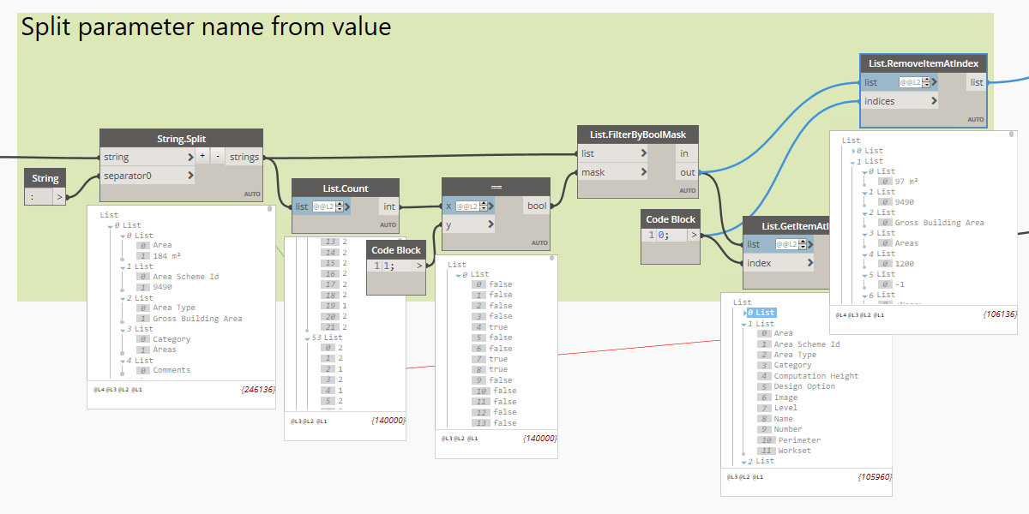
script 1 | Element Data
Split the parameter fields at the : to get the Parameter and the Value
Using the count of elements in the list, empty values can be filtered out
Both grabbing and removing the elements at index 0 will create the 2 lists (parameters and values)

Slide 17
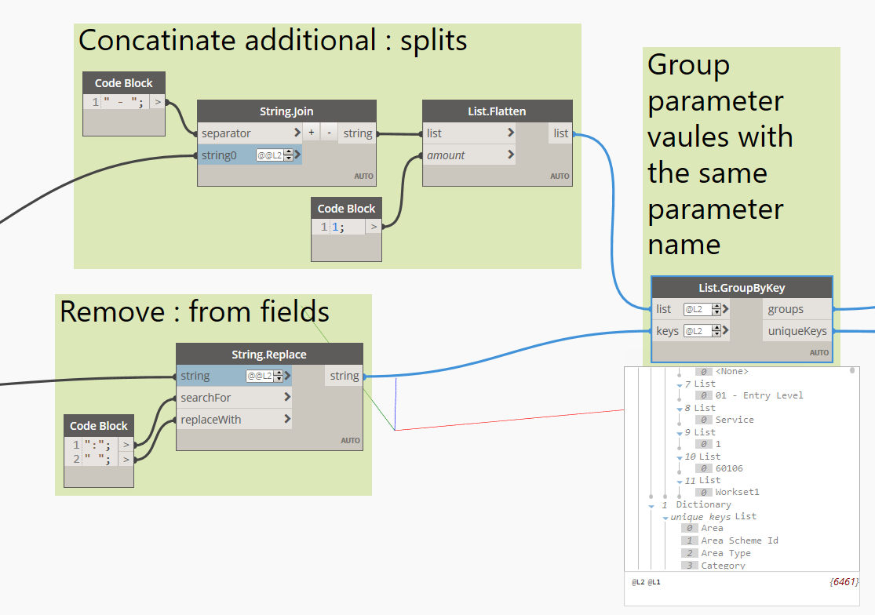
script 1 | Element Data
Join any values that may have been split
Remove any : left in the parameter name
Group all the values by parameter name

Slide 18
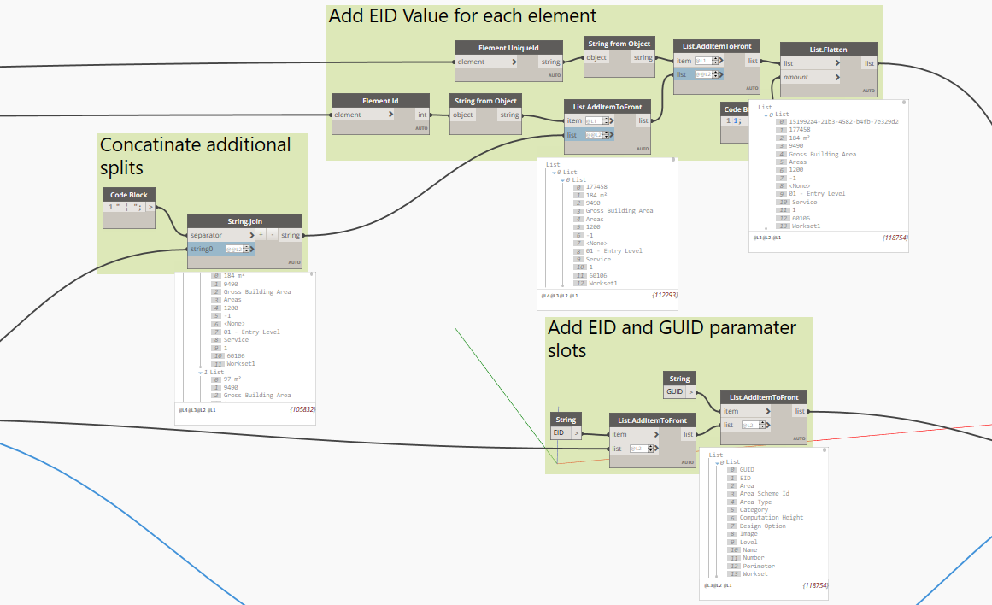
script 1 | Element Data
Join the values for parameters with the same name
Add the element ID and GUID values to the front of each element
Add the elements ID and GUID keys to each parameter list

Slide 19
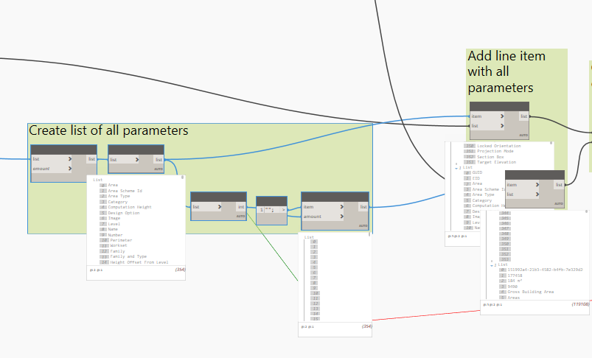
script 1 | Element Data
Create a list of all parameters
Create blank values for the list of parameters
Add these to the front of the values and keys lists

Slide 20
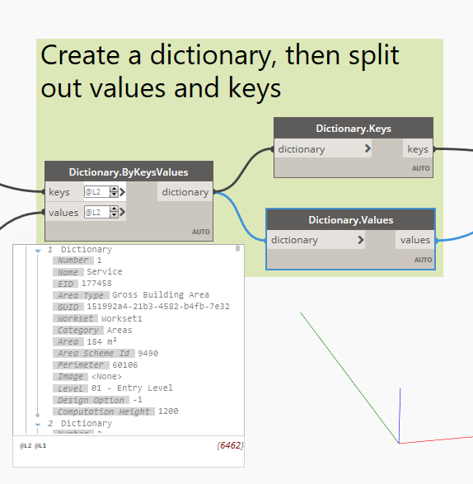
script 1 | Element Data
Create a dictionary with the parameter names and parameter values
Grab the dictionary Keys and Values

Slide 21
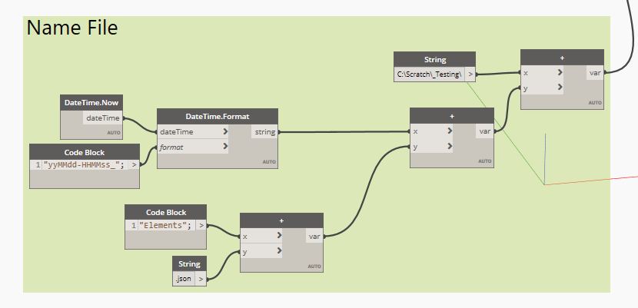
script 1 | Element Data
Create a file name and path string

Slide 22
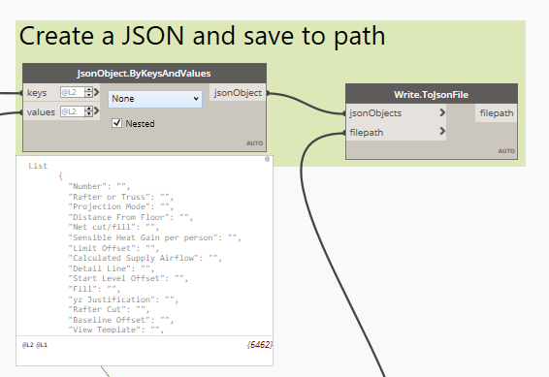
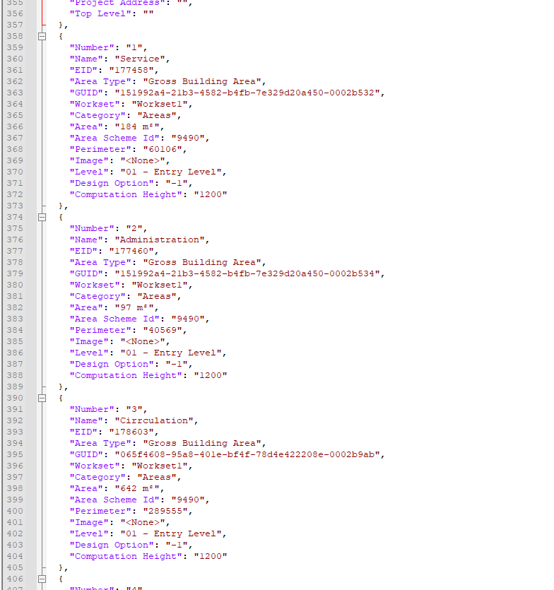
script 1 | Element Data
Convert dictionary keys and values to a JSON object
Write out the JSON

Slide 23
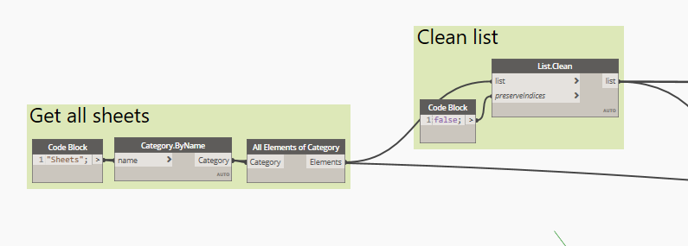
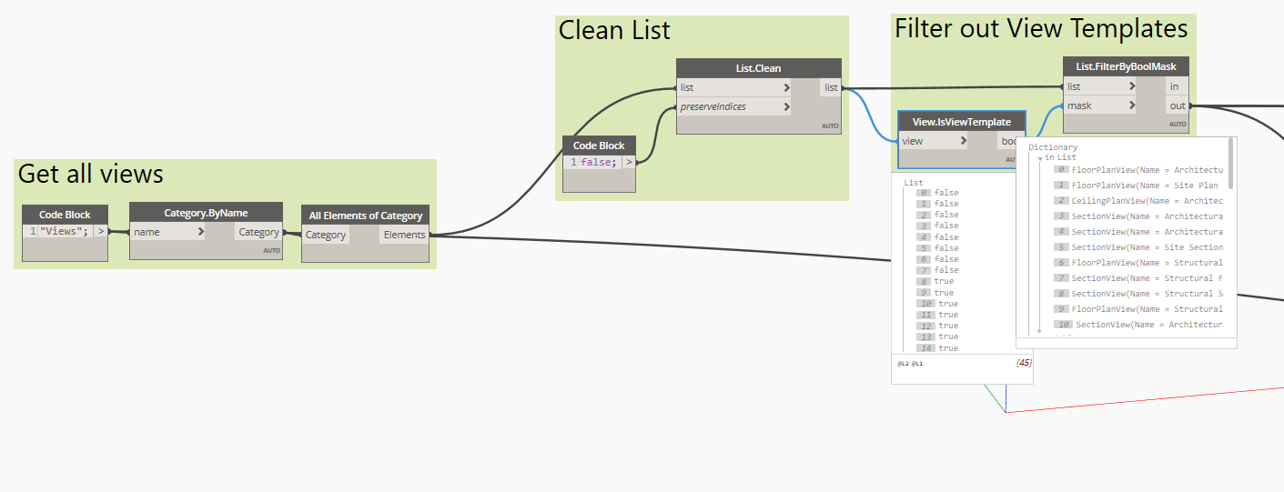
script 2 | Sheet / View
Select by category for both views and sheets
For views, filter our view templates

Slide 24
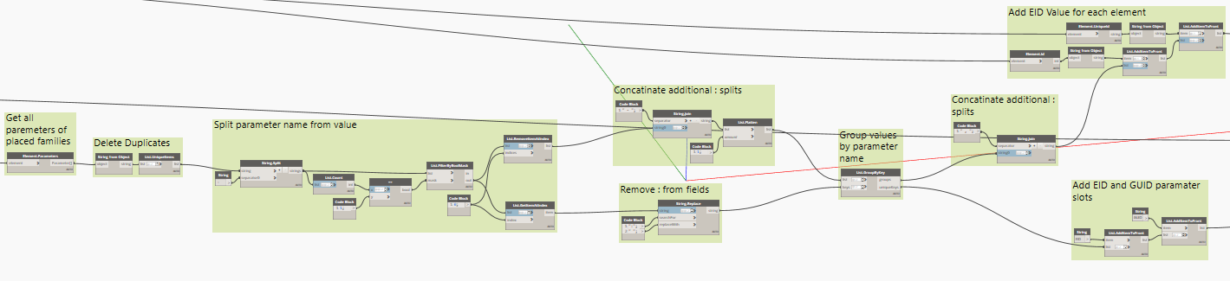
script 2 | Sheet / View
Center of the graph is identical to the elements graph

Slide 25
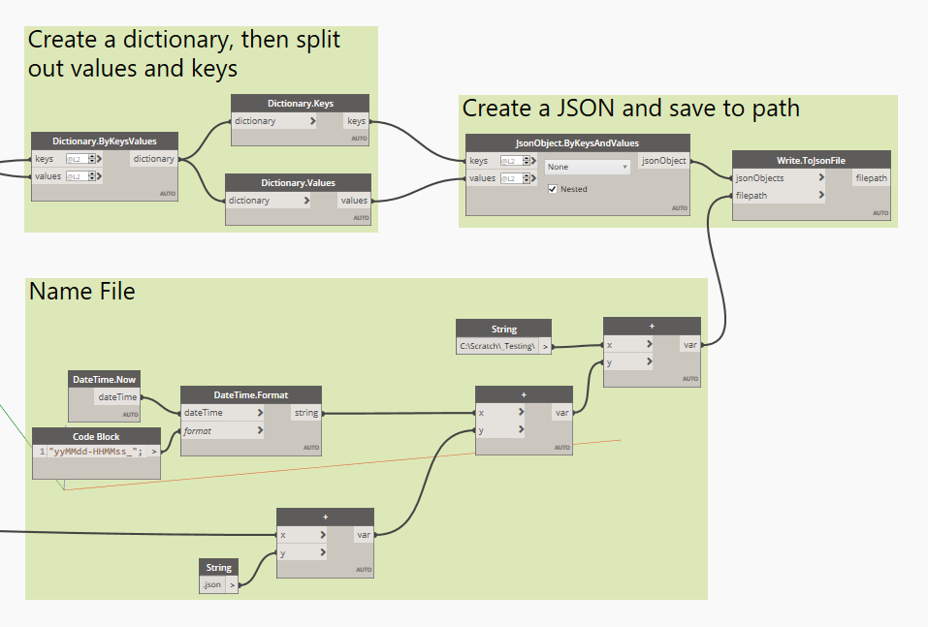
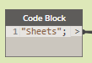
script 2 | Sheet / View
Create dictionary, create JSON and export are all the same from elements graph
Connected category name to file name

Slide 26
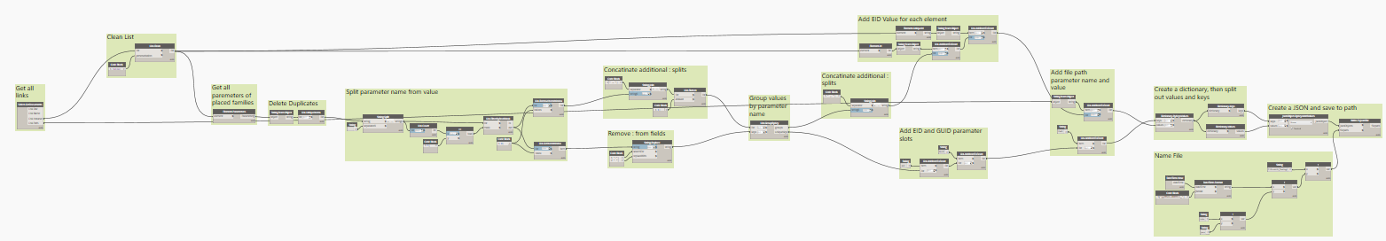
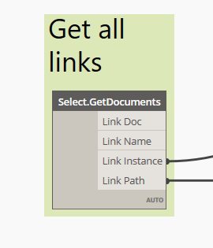
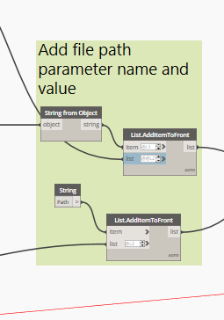
script 2 | Links
Most of the links graph is the same as views/sheets
Exceptions
Get links using archi-lab.net node
Add the link name and path to parameter list

Slide 27
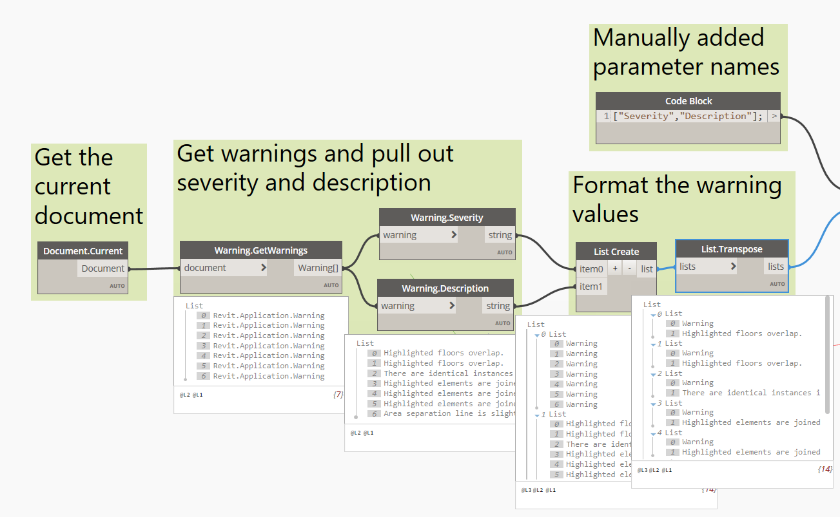
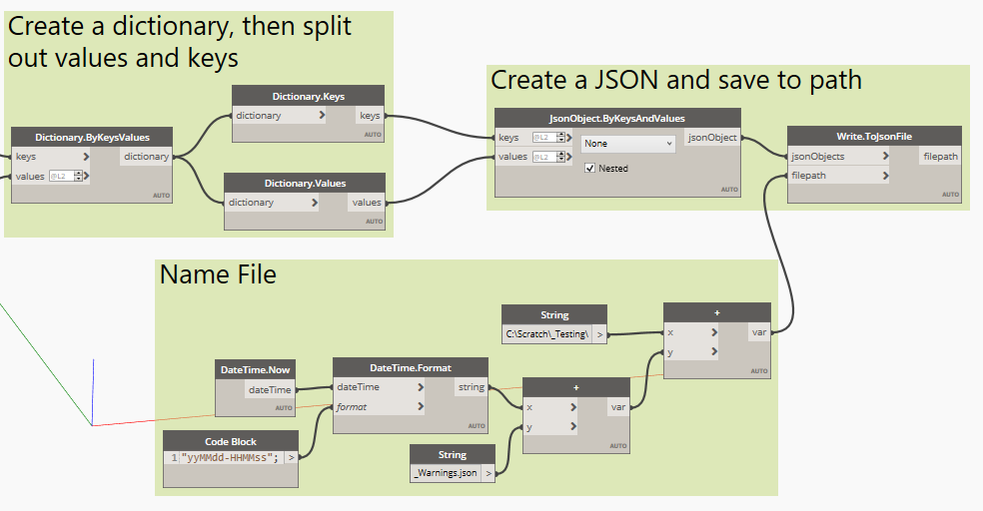
script 2 | Warnings
Use GetWarnings node to collect warnings
Extract the severity and descriptions
Reformat the list
Creating dictionary, JSON format, and file export are the same

Slide 28
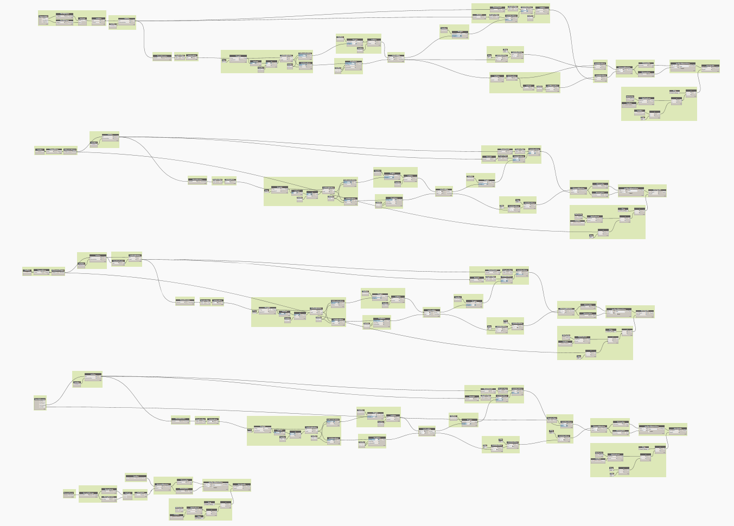
script 3 | All
For ease of use all the scripts can be combined

Slide 29
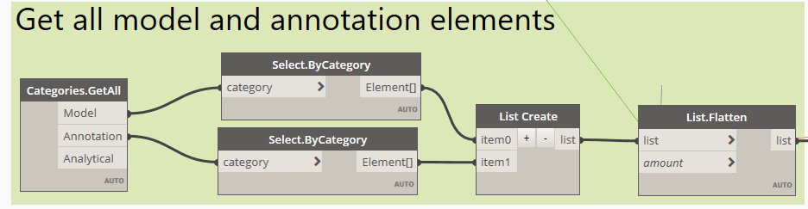
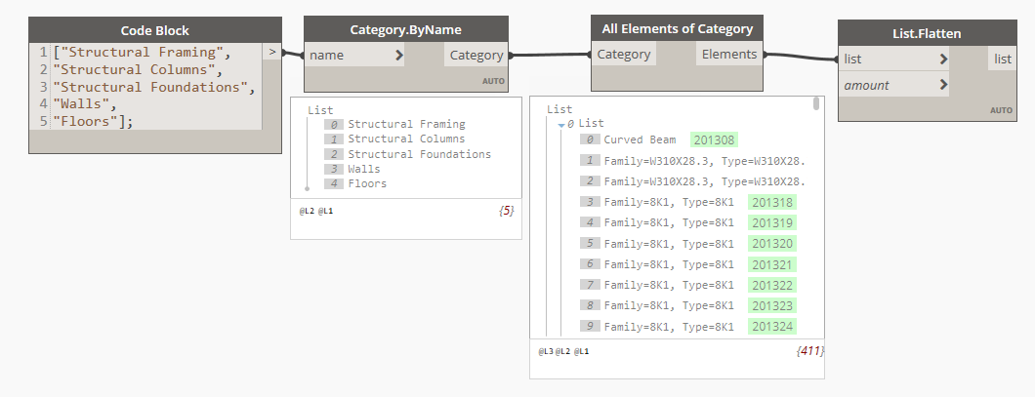
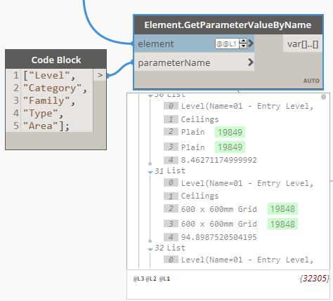
script 2 | Customizing the Script
Speed
Limit the extraction to model or annotation elements
Limit the extraction by category
Consistency
Limit the extraction to specific parameters

Slide 30
Expanding the Script(s)
Elements in view
File/ Project level info
Loaded, unplaced content
Overlapping elements
Geometry data

Slide 31
Import data into power bi
x5
POWER QUERY EDITOR
REPORT EDITOR
…as an end-user

Slide 32
Why power bi?
TT delivers data via Power BI platform
Shifts focus from processing to consuming / interpreting data
Desktop
Consistently clean and process model data automatically
Powerful beyond Excel…and Revit UI sucks for analysis
Desktop App is free and comes with most features (try before buying Pro)
Self-service tool empower users, does not require process ownership
Pro (and higher)
Collaborative features - web-based and centralized access (single source of truth)
Integrates well with Microsoft products, especially Teams and Sharepoint
Scheduled data refreshes to optimize workflow for end-users

Slide 33
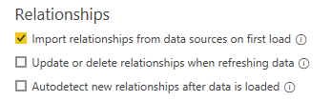
Preparation Checklist
Check your version of Power BI
Template made w/ May 2022 update
Power BI not backwards compatible for this version, so must use this version or later
Organize JSON files into single folder
When using Power BI template…
Turn off Auto-Detect Relationships
Power BI frequently and incorrectly tries to relate tables
Unexpected relationships can over constrain model and create refresh issues
Turn this off (if not already turned off)
File > Options and setting > Options > Current File: Data Load

Slide 34
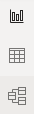
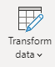
Anatomy of Power bi
What the developers sees (PQ) versus what the end user sees (report editor)
Roles
Developer
End-User / Consumer
Primary Sections in Power BI
Power Query Editor
Transform and optimize the flow of data that all users will consume
Report Editor
Define the intended user experience,
customize the display of information
Intended purpose
Process data so end users don’t have to
Make reports useful and usable
Subsections
Report View
Create and format visuals
Data View
Available data as a table
Model View
Table relationships

Slide 35
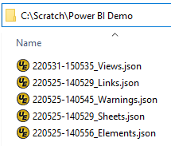
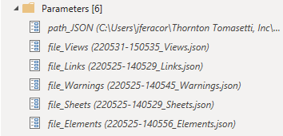
LOAD JSON Data into Power BI
New users only need to load data; advanced users may further customize
New Users:
Point the tool to the 5 JSON files in Power Query. Done!
Advanced Users:
Load more data, perform additional data transformations (e.g. joins, merges, delete unused columns, change column formatting)
Put your JSON files in a folder…
In the Power BI template, there are 6 ‘Parameters’ in Power Query editor you need to provide inputs for:
path_JSON
file_Views
file_Links
file_Warnings
file_Sheets
file_Elements

Slide 36
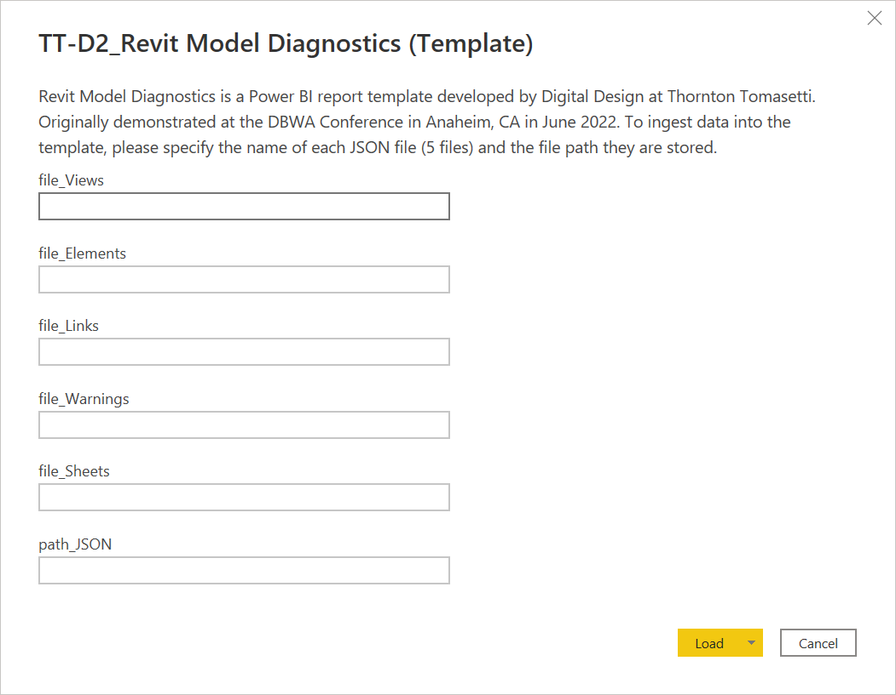
LOAD JSON Data into Power BI (cont.)
New users only need to load data; advanced users may further customize
New Users:
Point the tool to the 5 JSON files in Power Query. Done!
Advanced Users:
Load more data, perform additional data transformations (e.g. joins, merges, delete unused columns, change column formatting)
You will be prompted to enter these parameters when you open the template for the first time
file_Views
Edit the values to match the name of your JSON file + folder path
file_Elements
file_Links
file_Warnings
file_Sheets
Press ‘Load’ when done
path_JSON

Slide 37
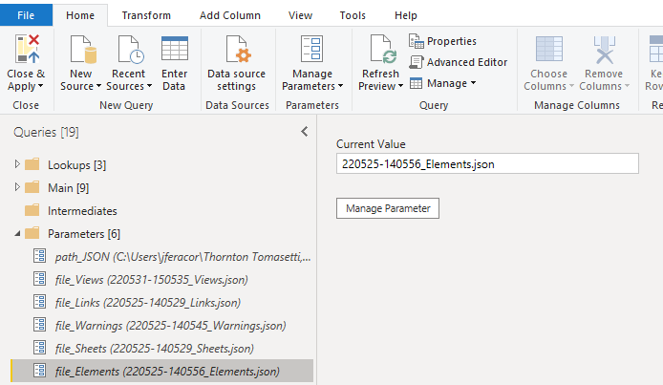
LOAD JSON Data into Power BI (cont)
ADVANCED TOPIC
If you want to modify the parameters in the future…
(4) After updating all [6] parameters, press ‘Close & Apply’ (top left icon)
(2) …then edit the value to match the name of your JSON file (or folder path)
(3) repeat step for the other 4 JSON files + the parent folder path
path_JSON
file_Views
file_Links
file_Warnings
(1) Click on a parameter to see its current value in the pane to the right…
file_Sheets
file_Elements

Slide 38
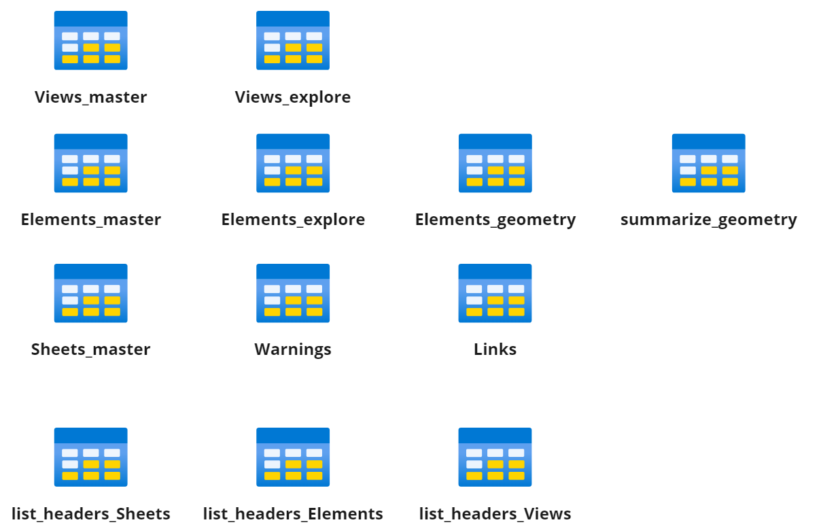
LOAD JSON Data into Power BI (Cont)
ADVANCED TOPIC
Query folders are optional, but help you stay organize
Main
Parameters
Primary data tables used to create model + report visuals
Parameters that allow you to swap while JSON files are loaded into the report (from previous slides)
Query Errors
Summary of errors that may have occurred when loading your data
Lookups
Intermediates
Incoming
(Optional) for header tables. Can assist with dev
(Optional) A place to put tables necessary for calculations but not needed for any specific visual. For developers.
(Optional) Folder for new queries while in development or scratch work

Slide 39
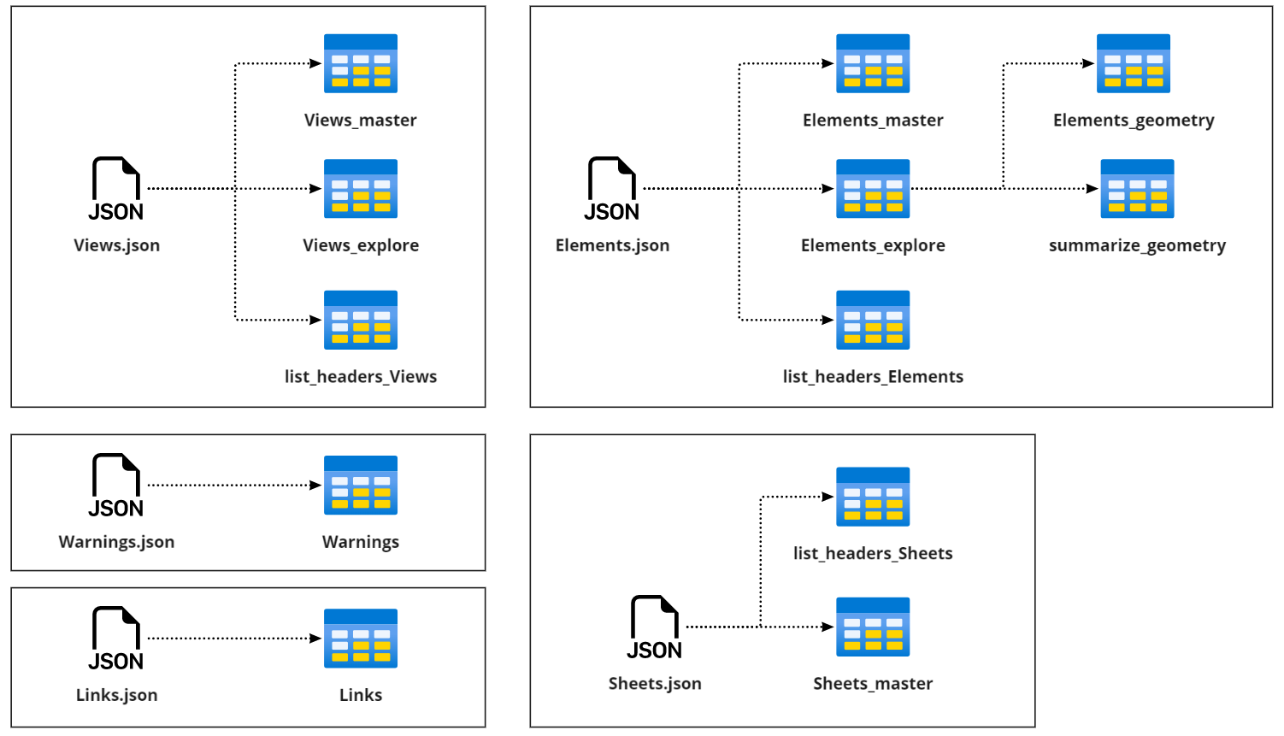
JSON Data Contents
ADVANCED TOPIC
Mapping JSON to Tables
Data Cleaning Steps
Split large tables into components
Clean data for formatting
truncate multi-values cells
consistent values
consistent column headers
separate units from quantities
Summarize tables for visuals
Optional (but helpful)
Generate lists of column headers to assist with development

Slide 40
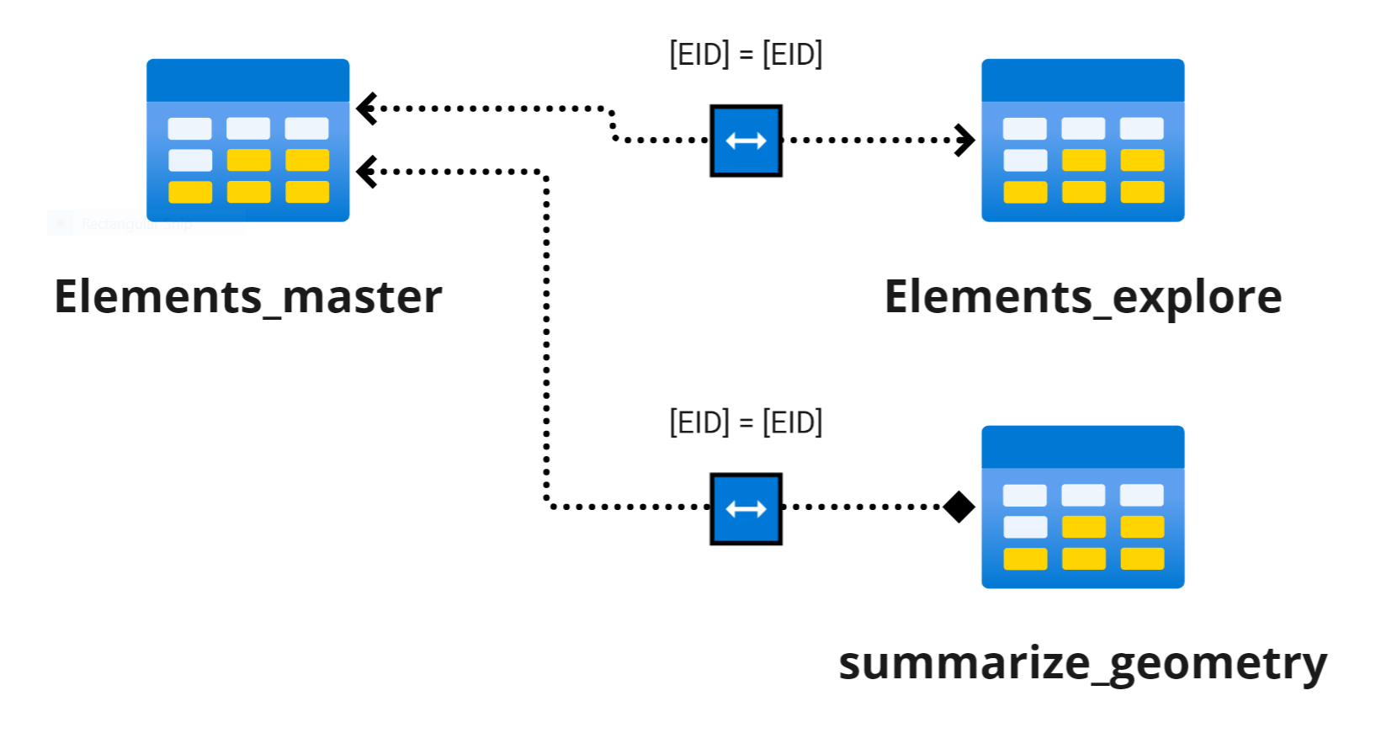
Why do we need to transform data?
ADVANCED TOPIC
Transformations pre-programmed in the template make data tables modular
Steps for Elements_master
1. Load raw data
2. Create duplicate for Elements_explore
3. Remove all other columns except GUID or EID and any columns to be used as slicers for Views
4. Filter any rows not needed
Steps for Elements_explore
Remove all columns used in Elements_master except for GUID or EID
(optional) Reformat columns (e.g. change formats to numbers, separate units from quantities, split, etc.)
(optional) Filter any rows not needed
(optional) replace values for consistency (handle blanks, nulls, white spaces)
All tables based on Elements should be connected to Elements_master via [EID]

Slide 41
CUSTOMIZE POWER BI
x5
POWER QUERY EDITOR
REPORT EDITOR

Slide 42
Customize Power BI Report
Use Report Editor to align report content to specific needs of intended end users
Use Power BI Report editor to
Two areas of customization to focus on: perceived usefulness, perceived usability
Perceived Usefulness: How useful is data model + data visualizations?
Perceived Usability: Can users navigate it on their own?
Model Considerations
Additional / alternative visualizations (details)
Additional measures, calculated columns, or tables
Key performance metrics
Table relationships (cardinality and direction)
Usability Considerations
Slider syncing / Interactivity features
Tooltips and on-screen guidance
Links to company-specific resources / guidance
Buttons and bookmarks

Slide 43
IDEAS FOR Customizations
Add branding and customize aesthetics
Branding and Aesthetics
Users will find report more useful if it feels relevant to specific needs of company
Display information in manner that end users expect (standard metrics?)
Add tooltips that help users interpret what they see
Report Versioning + Control Complexity
Create alternative versions of pages or reports with different levels of detail
Hide details for casual users, but data available on demand

Slide 44
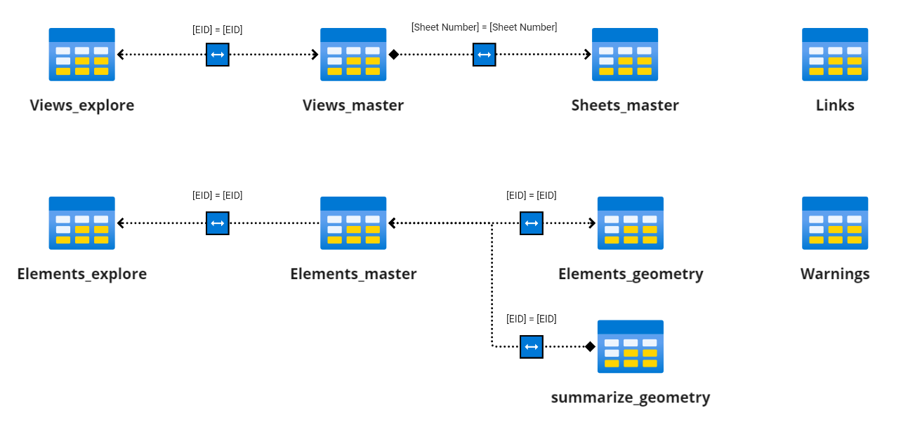
Data MODEL
ADVANCED TOPIC
For developers who want to expand on the template model
Data Model as it exists in the Power BI template
Note that Links and Warnings tables are not connected to the model
Future development could link elements to views and sheets they belong to
New tables based on Elements or Views should be related to their corresponding ‘master’ table
When creating slicers for views or elements, use the ‘master’ table columns
This ensures slicers are synced across pages

Slide 45
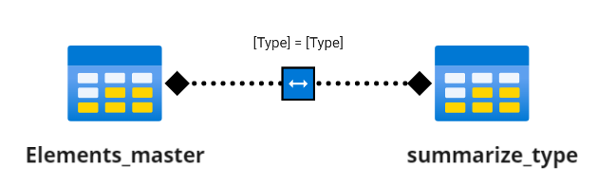
Example Customization #1
Add a calculated table + relate to existing model
Query: Which element types have over 200 elements in the model?
Solution: Create calculated table to filter elements table by the number of elements per category, then use as slicer.
1. Add Calculated Table w/ DAX
2. In Model View, relate summary table to master table on [Type] field (both directions)
summarize_type =
SUMMARIZE(Elements_master,[Type],
"Elements", COUNT(Elements_master[EID])
)

Slide 46
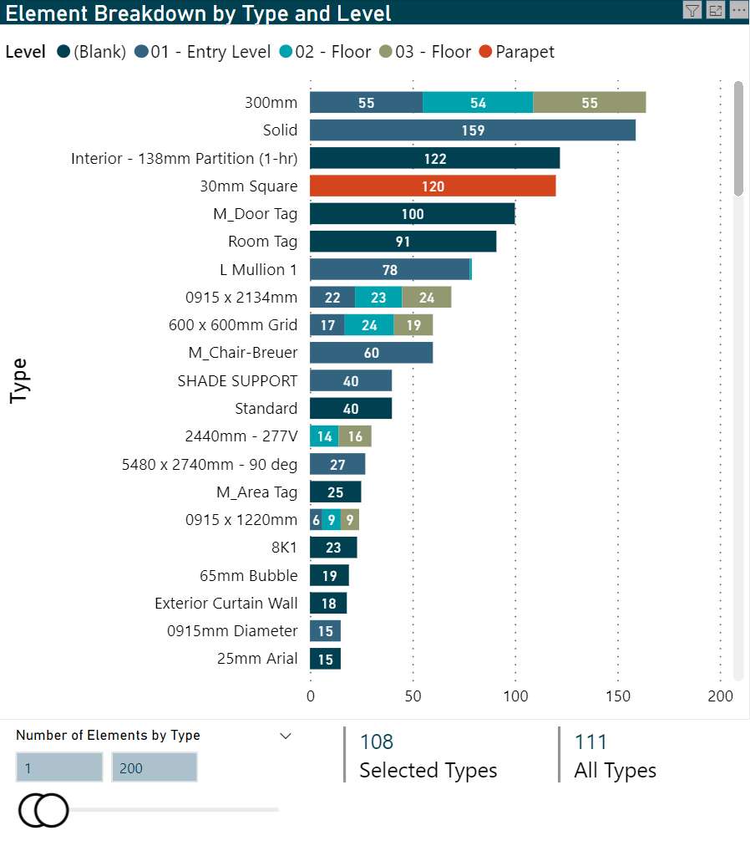
Example Customization #1
Add a calculated table + relate to existing model
Query: Which element types have over 200 elements in the model?
Solution: Create calculated table to filter elements table by the number of elements per category, then use as slicer.
ANSWER:
108 types w/ <200 elements
3 types w/ 200+ elements

Slide 47
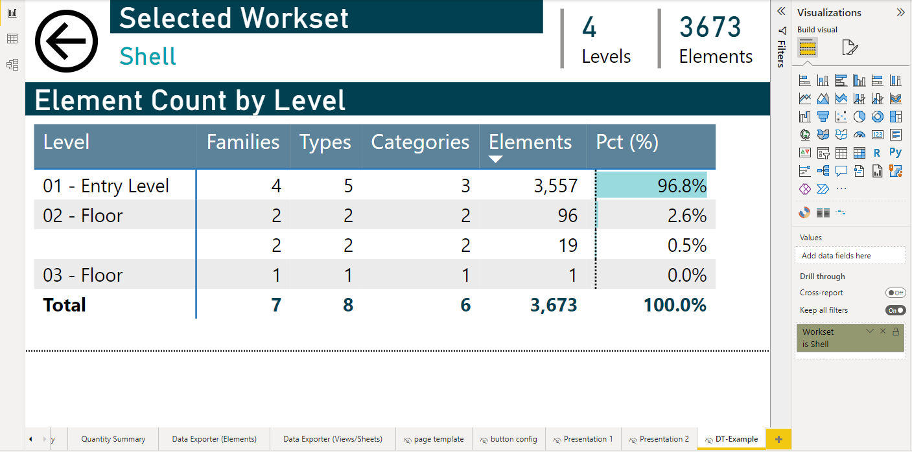
Example Customization #2
Add a drill through page
Query: What is the distribution of elements by Level for a selected Workset?
Solution: Create drill-through page with specific view user expecting
2. Under ‘Drill through’:
Turn ‘Keep all Filters’ on
Add ‘Elements_master’[Workset] to filter (MUST be column as table)
Back button automatically created when you add a field to Drill Through
1. Create a new page Make sure it is hidden (I called mine “DT-Example”

Slide 48
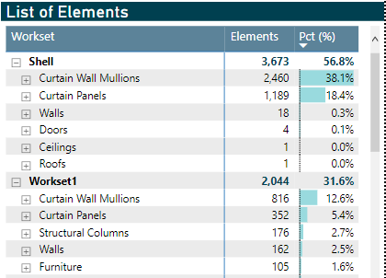
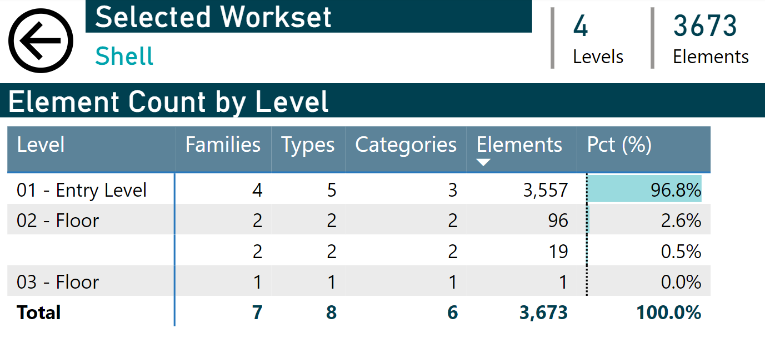
Example Customization #2
Add a drill through page
Query: What is the distribution of elements by Level for a selected Workset?
Solution: Create drill-through page with specific view user expecting
Dynamically see detailed breakdown of a selected Workset like this
Right click a Workset, then select ‘Drill Through’
From ‘Element Summary’ page
'Hidden’ Drill Through page (‘DT-Example’)

Slide 49
Develop your ROADMAP
x5
POWER QUERY EDITOR
REPORT EDITOR

Slide 50
Advantages and limitations
Consider the opportunity costs of your deployment
Advantages
Limitations
General Points
Scripts are self-service, on demand Small footprint (JSON files)
Engaging interactive reports, rapid turn-around
Ability to add company-specific user guidance
Minimal focus on data processing
re
Cannot fully automate execution of Dynamo yet
Single model snapshot only; no comparison features
Power BI Desktop (Free Only)
Automatic, consistent, repeatable transformations
Source data unmodified by process
Allow users to export filtered data as needed
Incremental development
No publishing, collaboration features
Does not leverage best features of Sharepoint
Sub-optimal workflow for end users, who must refresh data each time (takes time to re-calculate)
Power BI Pro (or higher)
Web-based platform, centralized sharing
Dataflows + scheduled refreshes
Collaboration: Publishing, Teams integration
Row-based security, incremental refresh
Complex merges cannot be done without Premium level (but there are workarounds!)
JSON files are not centrally managed (no tracking)
ADVANCED TOPICS

Slide 51
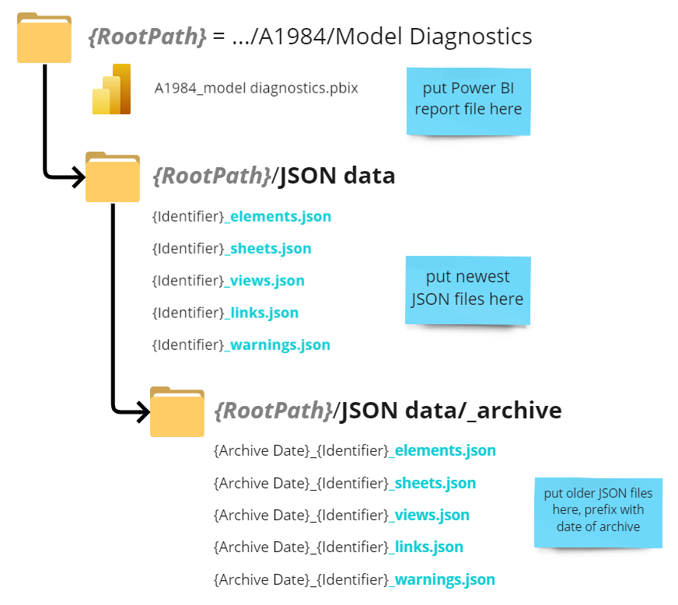
Structure your files and folders
How to repeat this analysis consistently, improve workflow automation
Why do this?
Stronger naming / structure conventions enables tools like Power BI to locate and distinguish JSON files intelligently
Develop folder structure and naming system
Allows Power BI to programmatically find JSON files by version, project, model based on path and file name
Date stamp older data (YYYYMMDD)
Separate data from dashboards
Make most current file name consistent
Allows for future expansion
{identifier} should uniquely identify model and project corresponding to JSON file

Slide 52

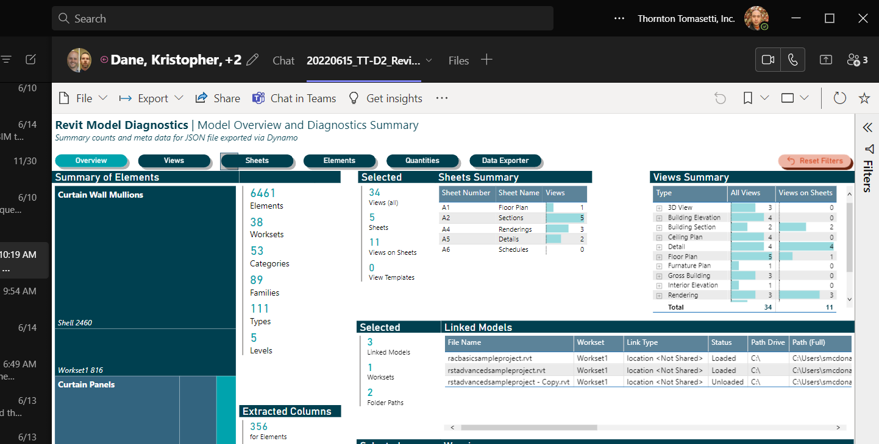
Publish and Share
This template is a good example of where the cost of Power BI Pro is justifiable!
How to repeat this analysis consistently, improve workflow automation
Why do this?
Publishing and refresh automation are among the most useful features of Pro in terms of workflow efficiency and optimizing the end user experience
Publish your Dashboard to a workspace
Provide users access to workspace
Provide users persistent link to report (or just have users log in to web platform)
Pin Power BI report to Microsoft teams
Use dataflows, schedule refreshes
Pre-calculates data for dashboards to reduce load time for end users (more efficient)

Slide 53
Leverage Power Automate
ADVANCED TOPIC
How to repeat this analysis consistently, improve workflow automation
Why do this?
Save time and reduce clerical reduce errors by automating data transfer and file renaming tasks
Create an ‘Incoming’ Folder
Establish a new connection to your folder in Power Automate + validate credentials
Create flow logic (not covered in this slide deck):
Trigger if new file added to Incoming folder
Check if files exist in destination folder
If files exist
prefix file name with current date in ISO format (YYYYMMDD)
Move renamed files to _archive folder
Otherwise
Move new files from Incoming to destination folder
4. Test flow by dropping off JSON files in Incoming Folder
Use Power Automate for File Management
Comes with Office 365 if you have it
Now allows connections to offline source (with proper credentials)
Move and rename files based on logic
Could also be done with Task Scheduler and PowerShell if you have the skills!
Can be combined with Microsoft Forms to further automatic intake process

Slide 54
FURTHER DEVELOPMENT
ADVANCED TOPIC
What features would be universally beneficial to all users?
Allow report to handle multiple snapshots, models
You need more data columns that distinguish which model, which snapshot, and which project
See folder structure recommendations
Key Performance Indices (KPI) – can we summarize a model’s quality with a single number?
Define thresholds that should cause concern to modeler or BIM manager (e.g. too many line styles? Too many views not on sheets?)
Metric allows you to track model health over time and across projects/models on demand

Slide 55
Your homework

Slide 56

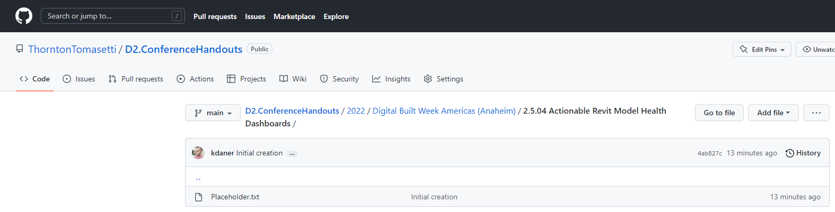
Your homework
Getting started on your own
Download file from GitHub Repo (see QR code)
Power BI Template
Dynamo Scripts
Additional Resources for Devs
Do the Preparation Checklist
Run Dynamo on a model
Save JSON files in a folder
Configure Template
Update parameters to JSON files + path
Refresh Data!
Optional Next Steps
Customize Template
Develop Roadmap
GitHub Repo

Slide 57
What’s in the GitHub Repo?
Table of Contents
Power BI reports (where Power BI template is stored)
Power BI Data
Where you should put your JSON files
Includes a sample set to help you start
Sample Models (Revit model used in demo)
Dynamo Scripts (Dynamo scripts to be run on Revit models)
Resources
Handouts / Notes
This slide deck

Slide 58
Thank you
Contact info
ThorntonTomasetti.com

Slide 59
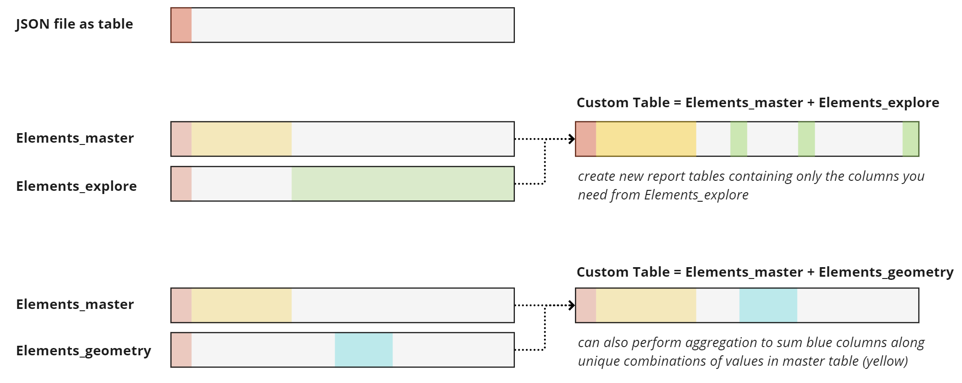
JSON Data Contents
ADVANCED TOPIC
How/why split big tables into smaller ones?
May need to apply 2 sets of filters to get different results simultaneously
Master table allows for centralized slicing of two related tables
Separate data by formatting (quantitative vs qualitative)
Easiest way to invite users to create custom tables

Slide 60



Data loading issues
ADVANCED TOPIC
Issue
Elements_geometry, Elements_explore, or summarize_geometry tables are loading data incorrectly
Explanation
Template tries to generalize steps, but your model contains attributes not included in template (particularly quantitative values)
To fix Elements_geometry…
In the step, 'Removed Columns', make sure that the column you are looking for was not removed
If the column has both units and value in the cell, you will need to split this column by a delimiter (usually a space), then rename the columns…

Slide 61


Data loading issues (cont.)
ADVANCED TOPIC
Issue
Elements_geometry, Elements_explore, or summarize_geometry tables are loading data incorrectly
To fix Summarize_geometry
Insert step after the 'Filtered Rows' step to remove any rows that you do not want to appear in the summary list
Add a new 'Unpivot Columns' step and unpivot only the columns you want to be summarized, then delete the old 'Unpivot Columns' step
Split the columns as needed to separate units from the value (cannot do math otherwise) + remove any remaining unwanted columns or rows

Slide 62

Data loading issues (cont.)
ADVANCED TOPIC
Issue
Power BI is looking for a column that does not exist in the JSON files
Explanation
Power BI is trying to generalize steps from the template to your specific data, but certain columns are missing from the JSON file
How to Fix?
(Recommended) add a new column to the JSON file; this will allow Power BI to continue, but the column values will be all empty
Better than trying to find every instance of it in Power BI…

Slide 63


Data loading issues (cont.)
ADVANCED TOPIC
Issue
Dyanmo files updated to add new data, but Power BI doesn't recognize new columns in Element-related tables
Explanation
Template does not include the new columns, so it will simply skip importing them.
How to fix:
Edit all table queries prefixed with Elements_ in PQ Editor. In the Advanced Editor within PQE:
…
In Advanced Editor within the 'Expanded Column' step, add the new column name at the end of the comma-separated list
(add column name at the end, e.g.
… “z Offset Value”, “NewColumnName”}
Add/remove rows or columns as necessary

Slide 64

Example Customization #3
ADVANCED TOPIC
Add a new measures and calculated columns
Query: How many views appear in sheets?
Solution: 3 different ways of getting this, but different use cases!
Option 1: ‘Lazy* Solution’
1. Use Views_master table
2. Count distinct sheet numbers and view names
3. Use filter to remove “---” from results. Done!
Why is this ‘lazy’?
For this calc to work, we manually set the filter to remove “---”
What if the user wants to see all the views but also see the number of Views on Sheets? Too bad.
What if we just want a single button to quickly filter to views on a sheet (all of them)? Also, too bad.

Slide 65
Example Customization #3
ADVANCED TOPIC
Add a new measures and calculated columns
Query: How many views appear in sheets?
Solution: 3 different ways of getting this, but different use cases!
IsViewOnSheet = IF( Views_master[Sheet Number] <> "---", "Yes", "No“ )
Option 2: Column Calc + Measure
Create a calculated column in View_master that indicates Yes/No if a view is on a sheet
Create a measure in View_master that counts rows where [Category] = “Views” and [Sheet Number] is NOT “---”
num_views_on_sheets = CALCULATE(
COUNTROWS(Views_master),
FILTER(ALL(Views_master),
Views_master[Category] = "Views" &&
Views_master[Sheet Number] <> "---"
)
)
Do we need both?
Yes, if you want to calculate the total views on sheets REGARDLESS of what filters are selected.
For example, if you filter out Sheet A2, you may want to know the SELECTED number of sheets on views versus the TOTAL number of sheets on views.

Slide 66

Example Customization #3
ADVANCED TOPIC
YES/NO Column allows us to select ALL views on sheets (rather than individually)
Add a new measures and calculated columns
Query: How many views appear in sheets?
Solution: 3 different ways of getting this, but different use cases!
Option 2: Column Calc + Measure
Create a calculated column in View_master that indicates Yes/No if a view is on a sheet
Create a measure in View_master that counts rows where [Category] = “Views” and [Sheet Number] is NOT “---”
Are there other ways?
Yep! Can create a calculated column in Sheets_master to find the total number of views per sheet (rather than Views_master) table, then add these numbers.
Advantageous b/c it gives you the views PER sheet as a filterable column, rather than a dynamic calculation (which cannot be used as a slicer).
When A2 is filtered out, only 6/11 views on sheets remain

